Slide 1
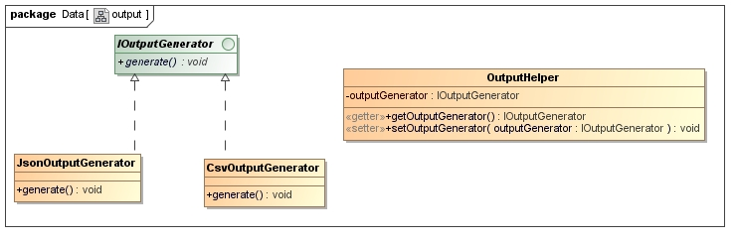
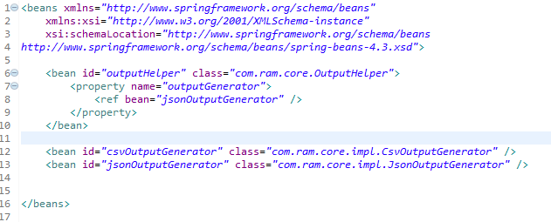
Setter Injection
Setter injection is most popular and simple DI method, it will injects the dependency via a setter method
A bean configuration file to declare the beans and set the dependency via setter injection (property tag).
Injects a ‘JsonOutputGenerator’ bean into ‘OutputHelper’ object via a setter method (setOutputGenerator).

Slide 2
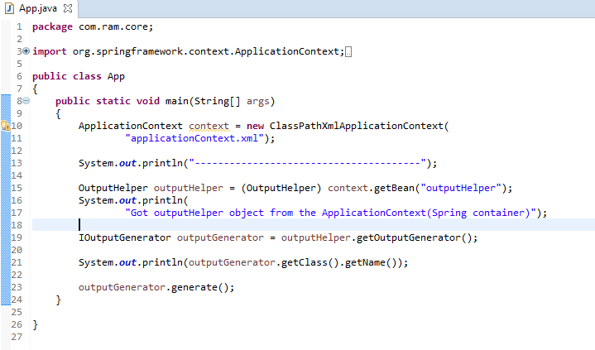
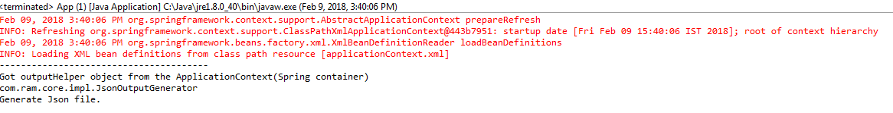
Setter Injection

